Slide 1


IMDB-Movie Analysis

Slide 2
Project description
The given project asks us to analyse IMDB Movie data.
The dataset provided is related to IMDB Movies. A potential problem to investigate could be: "What factors influence the success of a movie on IMDB?" Here, success can be defined by high IMDB ratings. The impact of this problem is significant for movie producers, directors, and investors who want to understand what makes a movie successful to make informed decisions in their future projects.

Slide 3
Approach The required analysis was done with the help of various functions, formulae and tools which excel provides us.
TECH STACK
MS Excel is used for the analysis.
The ease of use and familiarity with the tool is the reason for its selection.

Slide 4
Process Steps:
DATA UNDERSTANDING
DATA CLEANING
Dropping unnecessary columns.
Removing Blank Cell / Null Value.
Removing duplicates.
PERFORMING ANALYSIS.
GIVING INSIGHTS.

Slide 5
INSIGHTS

Slide 6
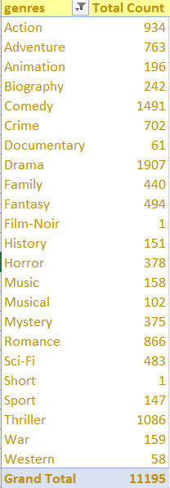
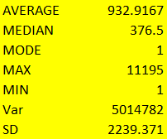
1) Movie Genre Analysis:
Total 24 genre types of movies are present.
Some of the most favorite genres are Drama,
Comedy, Thriller and Action.
Some of the least favorite genres are film-noir
and short films.

Slide 7
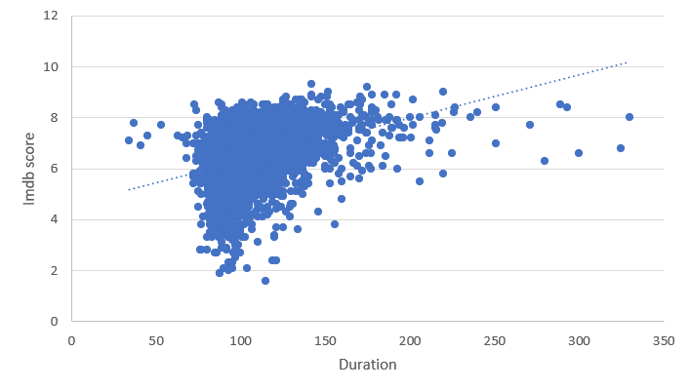
2) Movie Duration Analysis:
Average movie duration is 109.86.
Most of the movies seen is in the range between 90-140.
Movie duration range with highest IMDB ratings are between 100-150.
So, most effective duration range for a successful movie is between 90-150.

Slide 8
3) Language Analysis:
There are total 38 languages.
Overall average IMDB score is 7.26.
English language has the highest number of movies which is 3596.
Average IMDB rating of movies in English is 6.41.

Slide 9
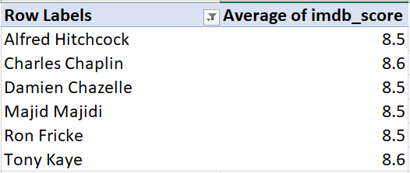
4) Director Analysis:
Overall IMDB score of the directors is 6.46.
Some of the top IMDB score directors are Alfred Hitchcock, Charles Chaplin, Damien Chazelle, Majid Majidi, Ron Fricke , Tony Kaye.
Charles Chaplin and Tony Kaye has the IMDB rating of 8.6.
Success rate of these directors are above 80%.

Slide 10


5) Budget Analysis:
Avatar was the most profitable movie.
Profit of Avatar is 523505847.
Correlation in the budget and profit is 0.222925855.
It is a weak positive correlation.

Slide 11
Learning Takeaway:
The given project helped me gain mastery in pivot tables, formulas and functions.
This helped in establishing an advance understanding for MS Excel.
Excel: https://docs.google.com/spreadsheets/d/1hLczXztG6YacOINgTCnfgNlsx8sIPJYO/edit?usp=sharing&ouid=105086523777475951343&rtpof=true&sd=true
Project Video Link:
https://drive.google.com/file/d/1zwfYzkt24sPNpfHuqPjYOP2X2YnPEZss/view?usp=sharing

